Slide 1
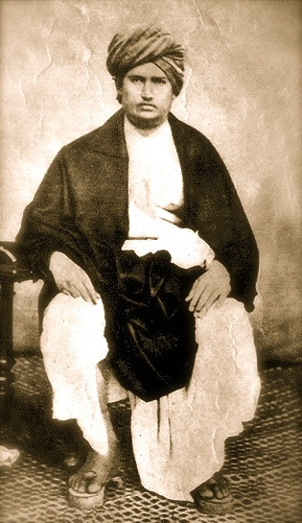
Life of Swami Dayanand Saraswati

Slide 2
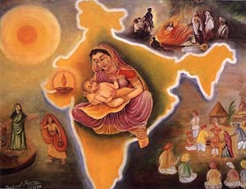
Life of Swami Dayanand Saraswati
Vedic Cultural Society (Hounslow)

Slide 3
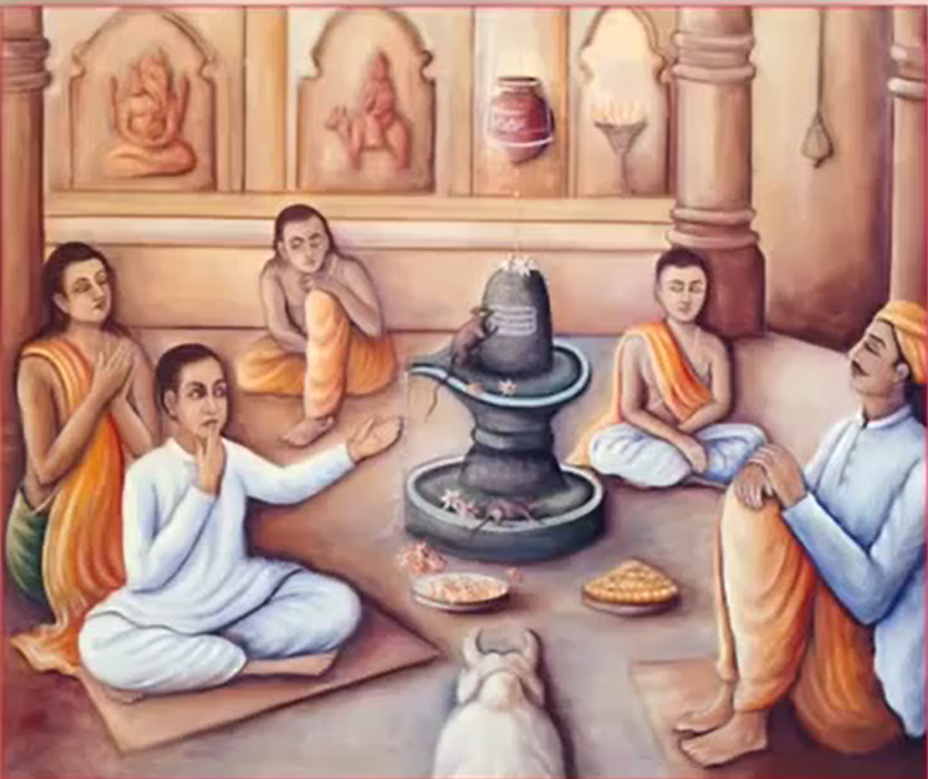
Life of Swami Dayanand Saraswati
Aryan Cultural Society Surrey

Slide 4
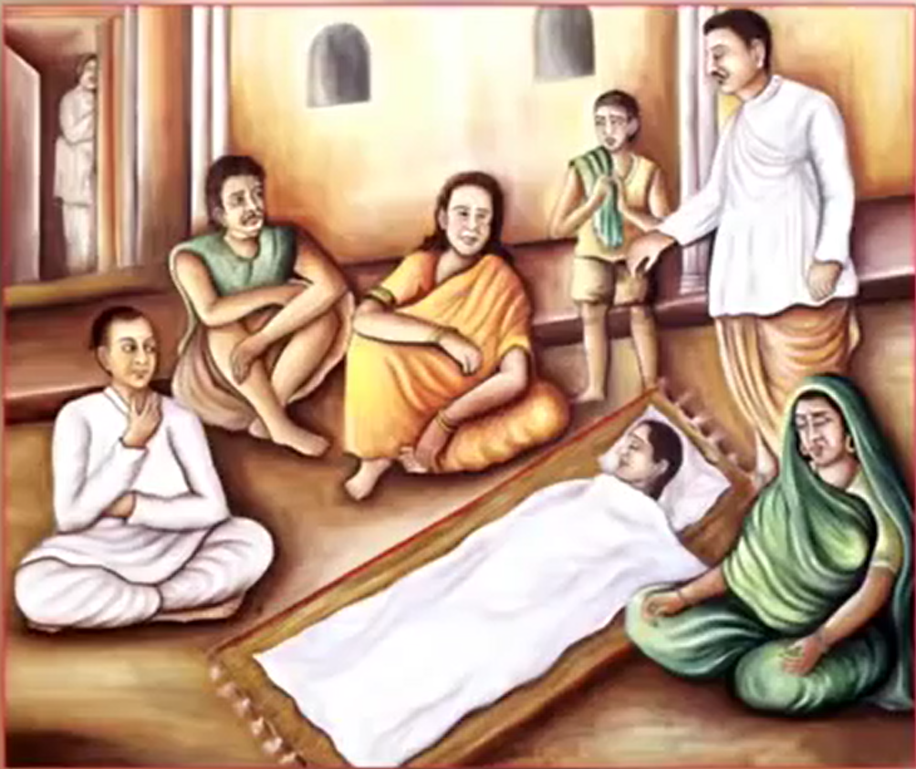
Life of Swami Dayanand Saraswati
Aryan Cultural Society Surrey

Slide 5
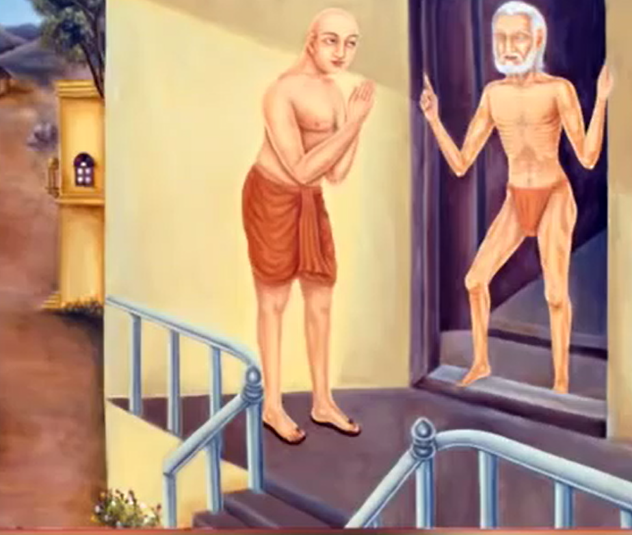
Life of Swami Dayanand Saraswati
Aryan Cultural Society Surrey

Slide 6
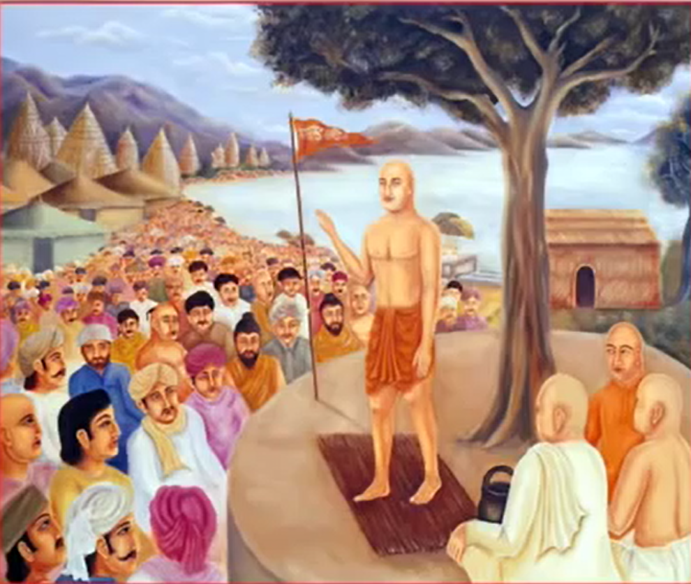
Life of Swami Dayanand Saraswati
Aryan Cultural Society Surrey

Slide 7
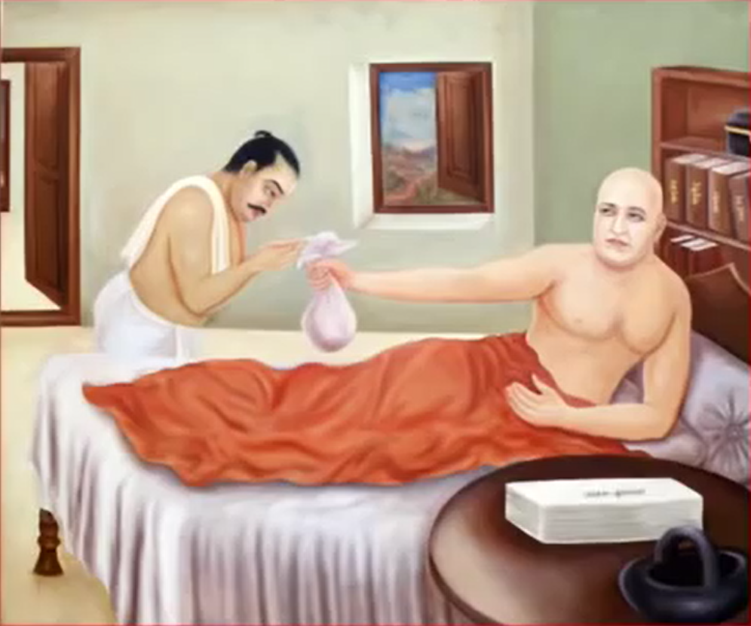
Life of Swami Dayanand Saraswati
Aryan Cultural Society Surrey

